Slide 1
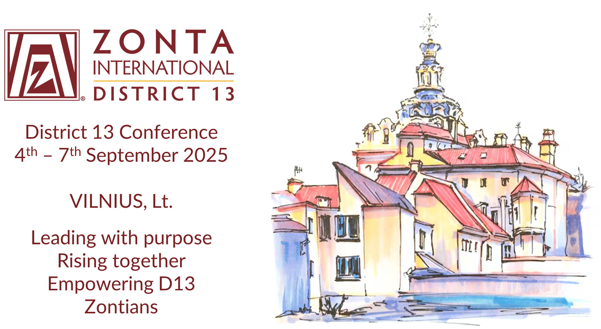
Welcome to Vilnius by Jurgita Šukevičienė
District 13 Conference
4th – 7th September 2025
Vilnius, Lithuania
Workshop
Future Zontian
Leading with purpose – Rising together – Empowering District 13 Zontians

Slide 2
"How does the future Zontian look like and
how do we empower (young) Zontians to work for women’s rights”
Workshop Structure
1. Welcome & Setting the Stage (10 minutes)
Quick introduction (facilitator explains workshop goals and ways of working)
Ice-breaker: “One Word” – Each participant says one word they associate with ‘future Zontian’ or ‘empowerment’.
2. Visioning Activity: Future Zontian Persona (30 minutes)
Small Group Work (3 groups):
  Each group creates a persona (“Future Zontian”)—profile, values, skills, passions, challenges, ambitions.
  Use flipcharts or sticky notes for visualization.
Gallery Walk: Each groups pin their personas.
3. Empowerment Brainstorm: How Do We Empower Young Zontians? (40 minutes)
Small Group Work (same 3 groups):
  Discuss how to do mentorship, skill-building, advocacy, networking, visibility etc.
Each group explains to the rest

Slide 3
"How does the future Zontian look like and
how do we empower (young) Zontians to work for women’s rights”
Ice-breaker: “One Word” – Each participant writes in the yellow post-i one word they associate with ‘future Zontian’ or ‘empowerment’
Engaged
Highly educated
Gen Z & Gen i
Strong
Equal
Student
Sly
Aware of the state of the world
Educated
International
Vocational educated
Works with hands
Enthusiastic
Fights against child marriage
Communicative
Brave
Broad thinker
Role model
Powerful
Determined
Active in Zonta
Targeted
Embrace diversity
Smart
Resilient
Notes:
The words generated were:
EQUAL, ENGAGED (5), STUDENT, STRONG, EDUCATED, VOCATIONAL EDUCATED, WORKING WITH HANDS, HIGHLY EDUCATED (2), AWARE OF THE STATE OF THE WORLD, SLY, ENTHUSIASTIC, COMMUNICATION, BRAVE, THINK WIDE, TARGETTED, FIGHT AGAINST CHILDREN MARRIAGE, POWERFUL, ROLE MODELLING, INTERNATIONAL, SMART, GEN Z, ACTIVE IN ZONTA, EMBRACES DIVERISTY

Slide 4
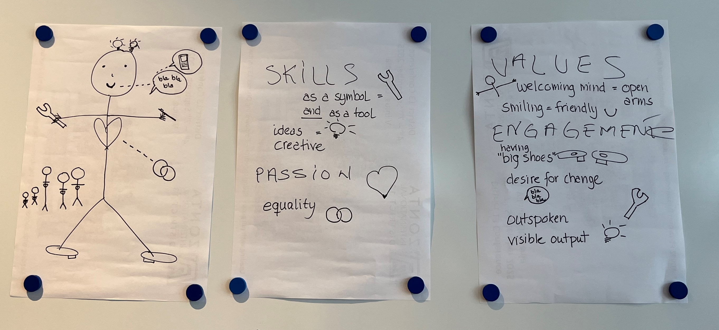
"How does the future Zontian look like and
how do we empower (young) Zontians to work for women’s rights”
2. Visioning Activity: Future Zontian Persona

Slide 5
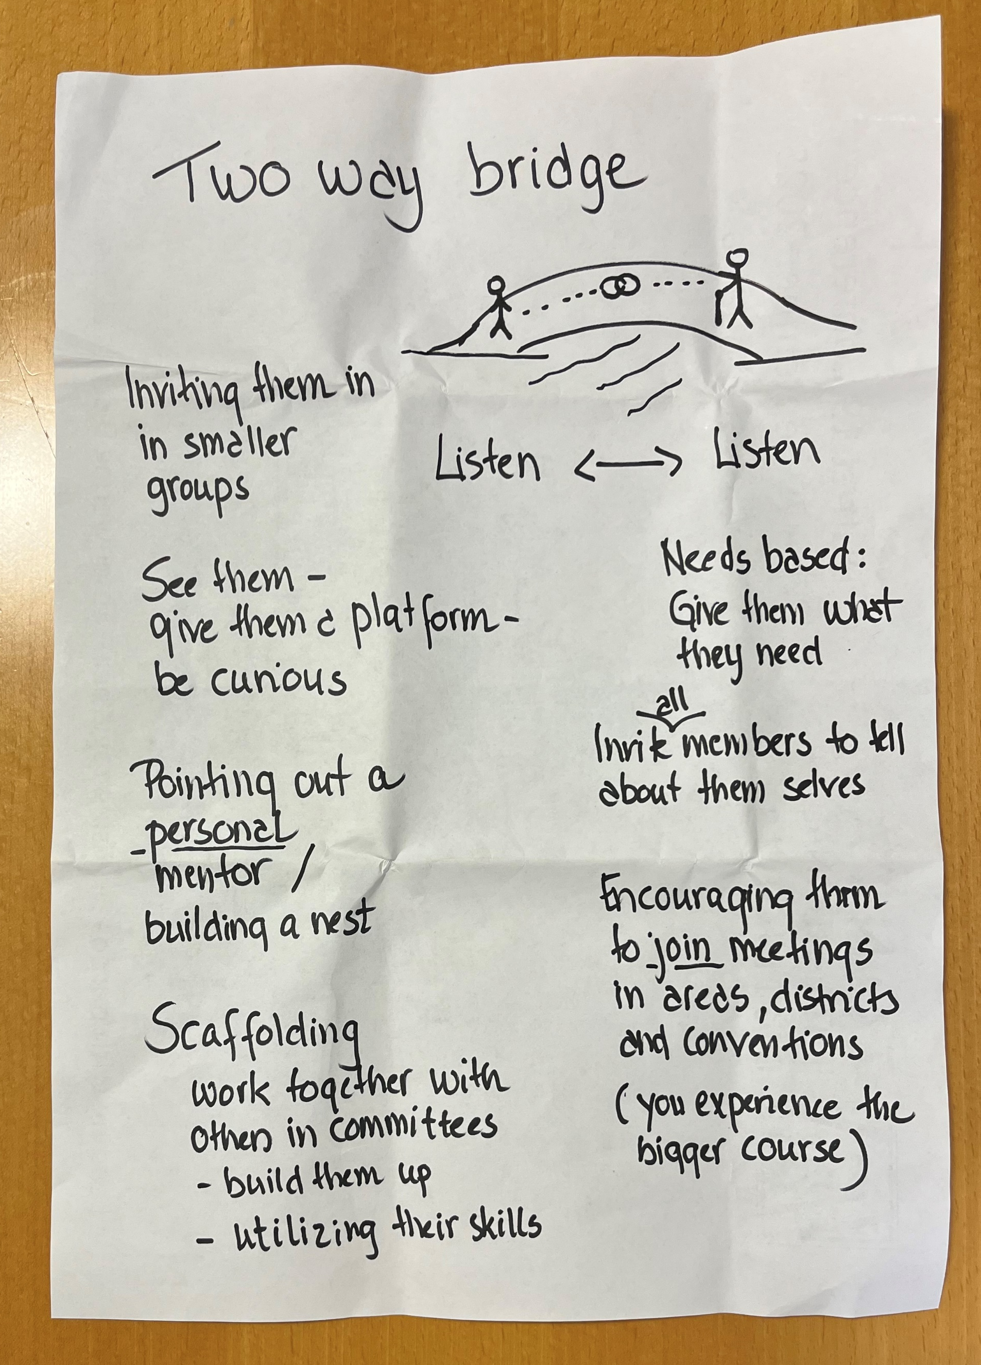
"How does the future Zontian look like and
how do we empower (young) Zontians to work for women’s rights”
3. Empowerment Brainstorm: How Do We Empower Young Zontians? And which skills
Working with other groups
Busy but still engaged
Adopt Zonta values
Skills – any and all (willing to use)
Vocal
Intersex
Mixed genders
Curiosity
Zonta knowledge
Diversity & inclusion
Visibility
Mixed sitting
Mentor programme
Clear offerings
Clear actions
Member fees
Training of skills
Knowledge about current affairs
Local projects
Working group engagement
Keep times
Flexibility

Slide 6
"How does the future Zontian look like and
how do we empower (young) Zontians to work for women’s rights”
3. Empowerment Brainstorm: How Do We Empower Young Zontians? And which skills
Skills
Open-minded
Life-long learning
Inspirational skills
Able to excel and make change
Dedication
Engagement
Ambition
Ability to listen to younger generation needs
Challenges
Social issues
Artificial intelligence
Generational differences
Ability to communicate
Social exclusion
To invite our daughters to join Zonta
Values
Generosity
Respectfulness
Solidarity
Confidence
Wisdom
Fellowship
Ambitions
To make Zonta more powerful and visible in the world
Reduce social exclusion
All people have equal rights
Passion
Passion for love and life to do changes for a better world

